Slide 1
Physics
Classroom Response System Questions
Twelfth Edition
Cutnell & Johnson
Reading Quiz Questions
Chapter 1
Introduction and Mathematical Concepts
Copyright ©2022 John Wiley & Sons, Inc.

Slide 2
1.1.1. Which of the following individuals did not make significant contributions in physics?
Galileo Galilei
Isaac Newton
James Clerk Maxwell
Neville Chamberlain

Slide 3
1.1.2. Which of the following statements is not a reason that physics is a required course for students in a wide variety of disciplines?
There are usually not enough courses for students to take.
Students can learn to think like physicists.
Students can learn to apply physics principles to a wide range of problems.
Physics is both fascinating and fundamental.
Physics has important things to say about our environment.

Slide 4
1.2.1. The text uses SI units. What do the “S” and the “I” stand for?
Système International
Science Institute
Swiss Institute
Systematic Information
Strong Interaction

Slide 5
1.2.2. Which of the following units is not an SI base unit?
slug
meter
kilogram
second

Slide 6
1.2.3. Complete the following statement: The standard meter is defined in terms of the speed of light because
all scientists have access to sunlight.
no agreement could be reached on a standard meter stick.
the yard is defined in terms of the speed of sound in air.
the normal meter is defined with respect to the circumference of the earth.
the speed of light is a universal constant.

Slide 7
1.2.4. Express 0.00592 in scientific notation.
5.92 × 10³
5.92 × 10⁻³
5.92 × 10⁻²
5.92 × 10⁻⁵
5.92 × 10⁵

Slide 8
1.2.5. The ratio
equals
10⁺³
10⁻³
10⁻⁶
10⁺⁶
100

Slide 9
1.2.6. In the International System of Units, mass is measured using which of the following units?
grams
kilograms
pounds
newtons
slugs

Slide 10
1.2.7. In the International System of Units, length is measured using which of the following units?
inches
feet
meters
centimeters
kilometers

Slide 11
1.2.8. How many meters are there in 12.5 kilometers?
1.25
125
1250
12 500
125 000

Slide 12
1.2.9 Express the quantity 12.5 meters in kilometers?
0.0125 km
0.125 km
1.25 km
12.5 km
125 km

Slide 13
1.2.10. By international agreement, the standard meter is currently defined by which of the following methods.
The standard meter is one-ten millionth of the distance between the Equator and the North Pole.
The standard meter is the length of the path traveled by light in a vacuum during a specific time interval.
The standard meter is the distance between two fine parallel lines on a platinum bar stored under vacuum near Paris, France.
The standard meter is defined in terms of a specific number of wavelengths of light emitted by a specific isotope of an inert gas.
The standard meter is defined in terms of the length of the tibia bone of a 17th century king.

Slide 14
1.2.11. How is the standard unit of time, the “second,” defined in the International System of Units?
using the frequency of the light emitted from the ideal gas krypton
using a standard pendulum that has a length of exactly one standard meter
using a portion of the time for a single rotation of the Earth
using a high precision telescope to measure the light coming from the most distant objects in the Universe
using a high precision cesium (atomic) clock

Slide 15
1.3.1. Which one of the following statements concerning unit conversion is false?
Units can be treated as algebraic quantities.
Units have no numerical significance, so 1.00 kilogram = 1.00 slug.
Unit conversion factors are given inside the front cover of the text.
The fact that multiplying an equation by a factor of 1 does not change an equation is important in unit conversion.
Only quantities with the same units can be added or subtracted.

Slide 16
1.3.2. Which one of the following pairs of units may not be added together, even after the appropriate unit conversions have been made?
feet and centimeters
seconds and slugs
meters and miles
grams and kilograms
hours and years.

Slide 17
1.3.3. Which one of the following terms is used to refer to the physical nature of a quantity and the type of unit used to specify it?
scalar
conversion
dimension
vector
symmetry

Slide 18
1.3.4. In dimensional analysis, the dimensions for speed are

Slide 19
1.4.1. Which one of the following terms is not a trigonometric function?
cosine
tangent
sine
hypotenuse
arc tangent

Slide 20
1.4.2. For a given angle θ, which one of the following is equal to the ratio of sin θ /cos θ?
one
zero
sin⁻¹ θ
arc cos θ
tan θ

Slide 21
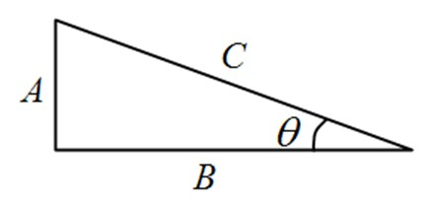
1.4.3. Referring to the triangle with sides labeled A, B, and C as shown, which of the following ratios is equal to the sine of the angle θ?

Slide 22
1.4.3. Referring to the triangle with sides labeled A, B, and C as shown, which of the following ratios is equal to the tangent of the angleθ?

Slide 23
1.4.5. Which law, postulate, or theorem states the following: “The square of the length of the hypotenuse of a right triangle is equal to the sum of the squares of the lengths of the other two sides.”
Snell’s law
Pythagorean theorem
Square postulate
Newton’s first law
Triangle theorem

Slide 24
1.5.1. Which one of the following statements is true concerning scalar quantities?
Scalar quantities have both magnitude and direction.
Scalar quantities must be represented by base units.
Scalar quantities can be added to vector quantities using rules of trigonometry.
Scalar quantities can be added to other scalar quantities using rules of ordinary addition.
Scalar quantities can be added to other scalar quantities using rules of trigonometry.

Slide 25
1.5.2. Which one of the following quantities is a vector quantity?
the age of the pyramids in Egypt
the mass of a watermelon
the sun's pull on the earth
the number of people on board an airplane
the temperature of molten lava

Slide 26
1.5.3. A vector is represented by an arrow. What is the significance of the length of the arrow?
Long arrows represent velocities and short arrows represent forces.
The length of the arrow is proportional to the magnitude of the vector.
Short arrows represent accelerations and long arrows represent velocities.
The length of the arrow indicates its direction.
There is no significance to the length of the arrow.

Slide 27
1.5.4. Which one of the following situations involves a vector quantity?
The mass of the Martian soil probe was 250 kg.
The overnight low temperature in Toronto was −4.0 °C.
The volume of the soft drink can is 0.360 liters.
The velocity of the rocket was 325 m/s, due east.
The light took approximately 500 s to travel from the sun to the earth.

Slide 28
1.6.1. and are vectors. Vector is directed due west and vector
is directed due north. Which of the following choices correctly indicates the directions of vectors − and − ?
− is directed due west; and − is directed due north.
b) − is directed due west; and − is directed due south.
c) − is directed due east; and − is directed due south.
d) − is directed due east; and − is directed due north.
e) − is directed due north; and − is directed due west.

Slide 29
1.6.2. Which one of the following statements concerning vectors and scalars is false?
In calculations, the vector components of a vector may be used in place of the vector itself.
It is possible to use vector components that are not perpendicular.
A scalar component may be either positive or negative.
A vector that is zero may have components other than zero.
Two vectors are equal only if they have the same magnitude and direction.

Slide 30
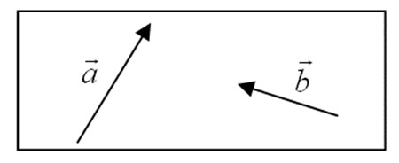
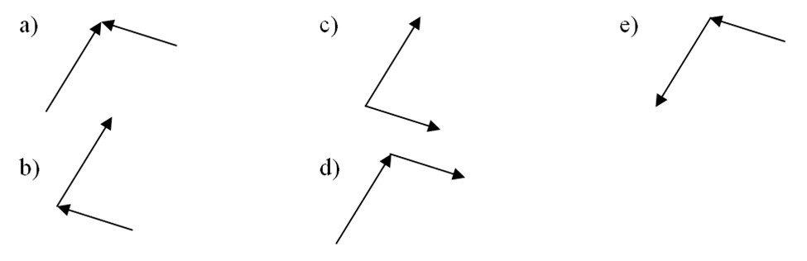
1.6.3. Consider the two vectors represented in the drawing. Which of the following options is the correct way to add graphically vectors
and
?

Slide 31
1.6.4. Consider the two vectors represented in the drawing. Which of the following options is the correct way to subtract graphically vectors
from vector
?

Slide 33
1.7.2. Vector
has a magnitude of 88 km/h and is directed at 25° relative to the x axis. Which of the following choices indicates the horizontal and vertical components of vector
 | r_{x} | r_{y}
 | +22 km/h | +66 km/h
 | +39 km/h | +79 km/h
 | +80 km/h | +39 km/h
 | +66 km/h | +22 km/h
 | +72 km/h | +48 km/h

Slide 34
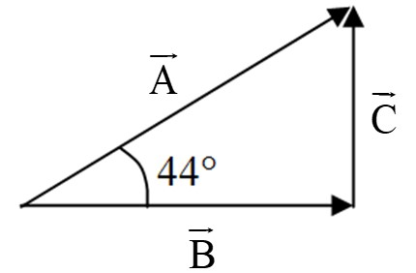
 | B_{x} | B_{y} | C_{x} | C_{y}
 | 63 | 0 | 0 | 61
 | 0 | 61 | 63 | 0
 | 63 | 0 | 61 | 0
 | 0 | 63 | 0 | 61
 | 61 | 0 | 63 | 0

Slide 35
 | C_{x} | C_{y}
 | 13m/s | −3m/s
 | 57m/s | −3m/s
 | 13m/s | 33m/s
 | 57m/s | 57m/s
 | −57m/s | 3m/s

Slide 36
1.8.2. The horizontal and vertical components of vector
are
, respectively. Neither is zero. Which one of the following statements concerning the sum of the magnitudes is true?
v_{x} + v_{x} = 0
The sum of the magnitudes of the two components is greater than the magnitude of
and
.
The sum of the magnitudes of the two components is less than the magnitude of
The sum of the magnitudes of the two components is equal to the magnitude of
The sum of the magnitudes of the two components is less than or equal to magnitude of

Slide 37
1.8.3. The horizontal and vertical components of vector
are
, respectively. Which one of the following statements concerning the vector sum of the two component vectors is true? (Neither component is zero.)
The sum of the magnitudes of the two components is greater than the magnitude of
The vector sum of the two components is greater than the magnitude of
and
The vector sum of the two components is less than the magnitude of
The vector sum of the two components is equal to the magnitude of
The vector sum of the two components is less than or equal to the magnitude of

